Slide 1
IN THE NAME OF GOD

Slide 2
Knee Sports Injuries

Slide 3
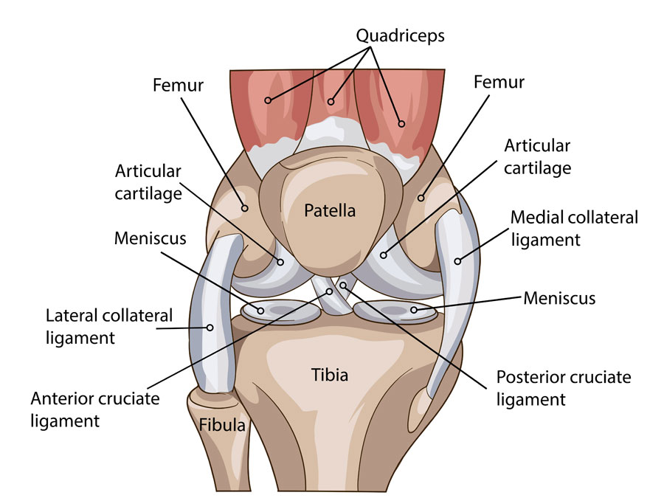
Knee Anatomy

Slide 4
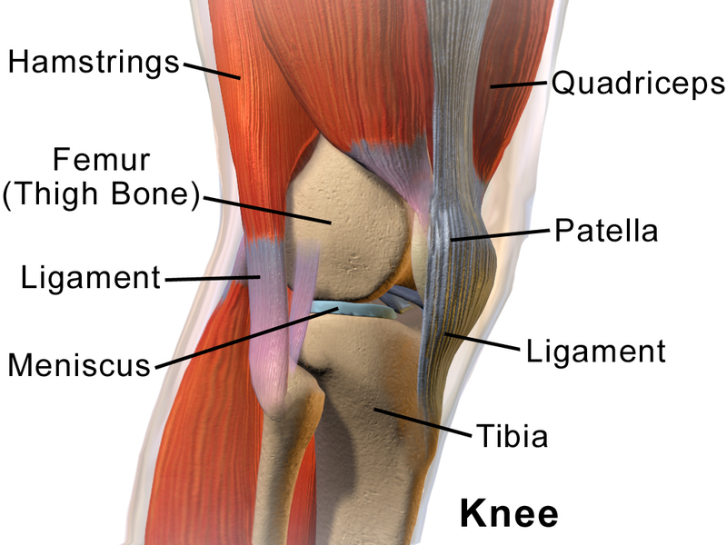
Knee Anatomy

Slide 5
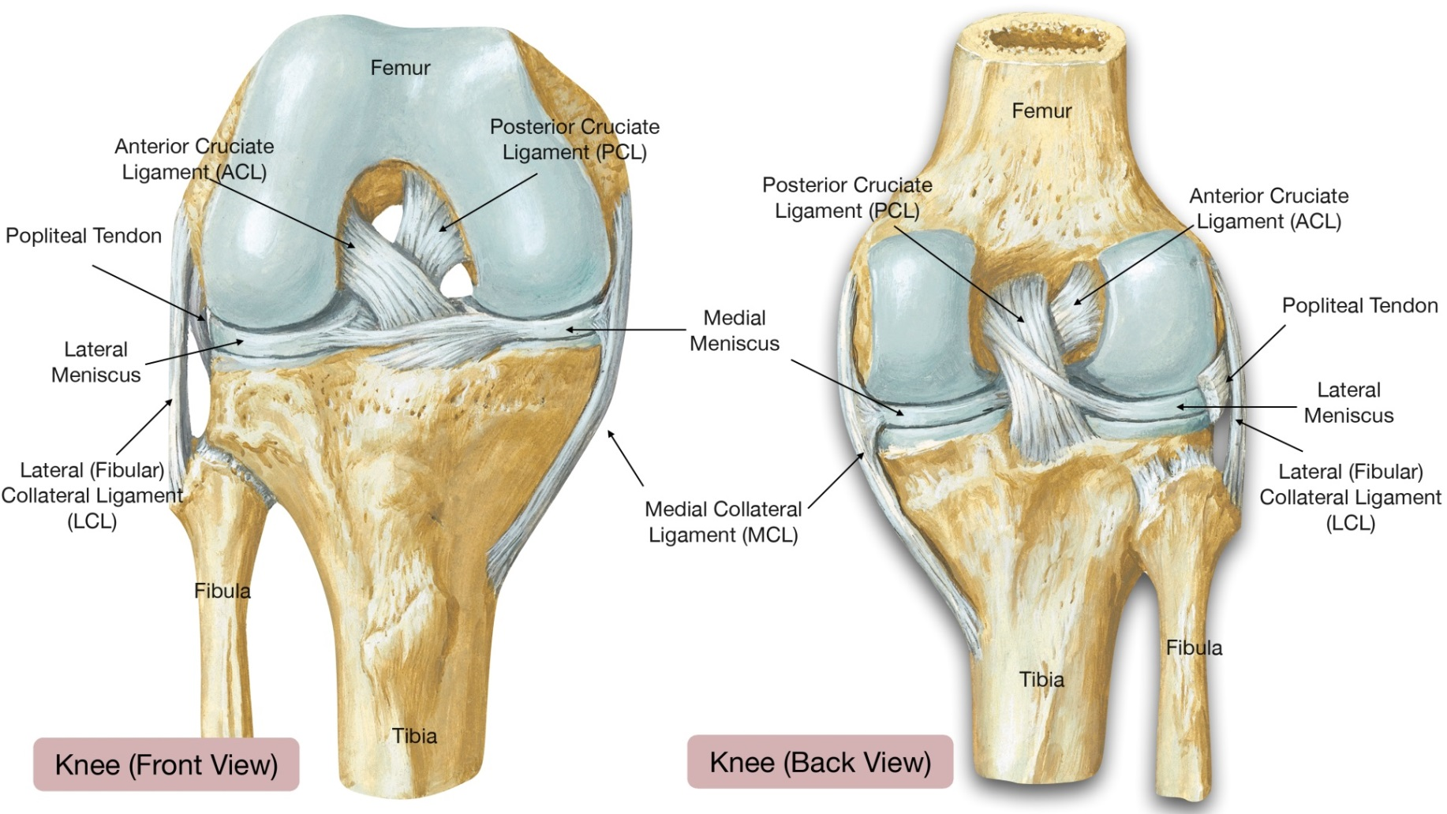
Knee Anatomy

Slide 6
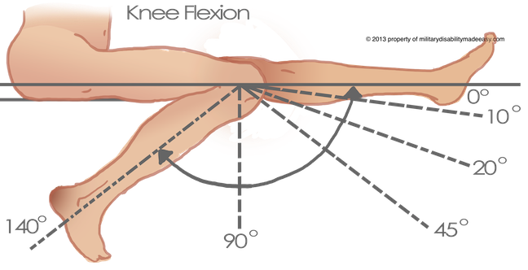
Knee ROM

Slide 7
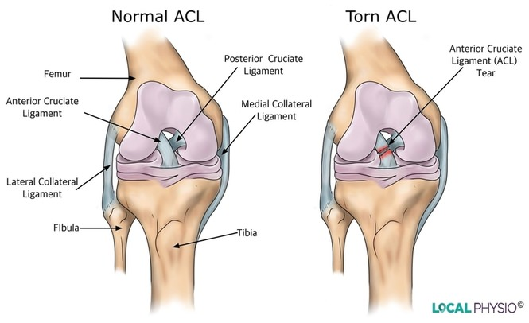
ACL Injury

Slide 8
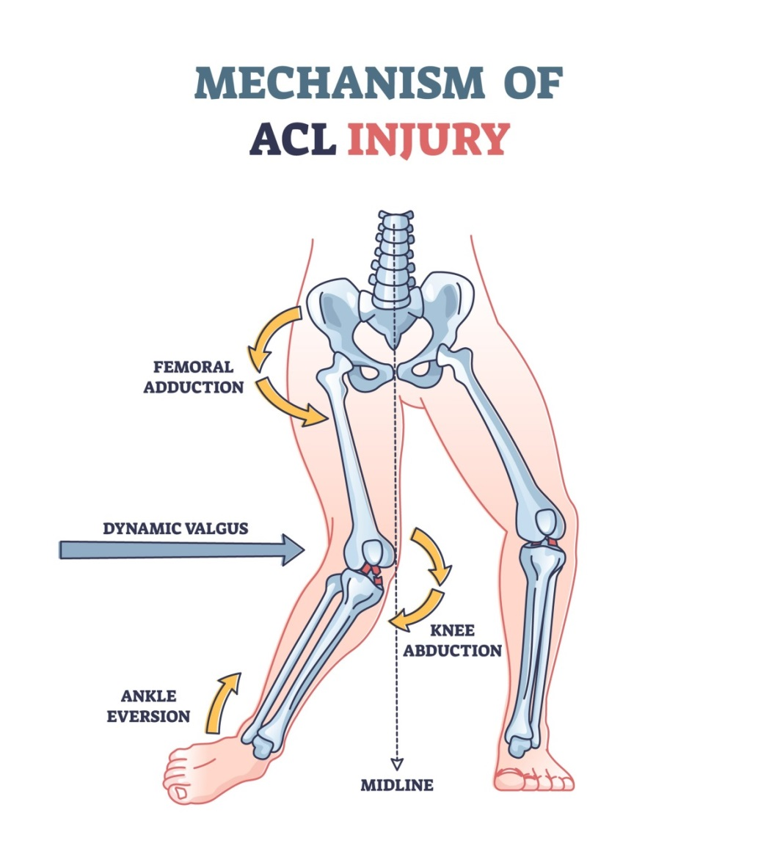
ACL Injury

Slide 9
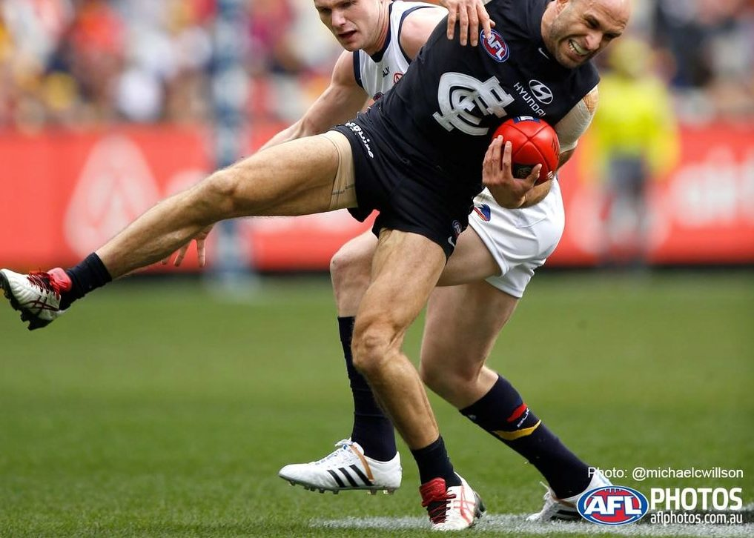
ACL Injury

Slide 10
ACL Injury
The most important Symptom:
KNEE GIVING WAY

Slide 11
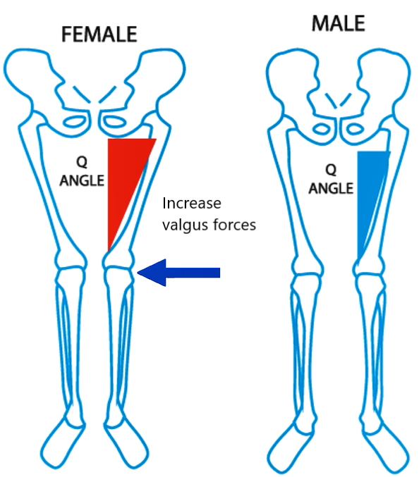
ACL Injury

Slide 12
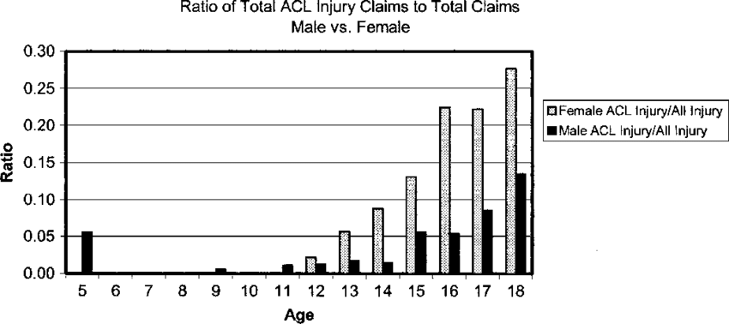
ACL Injury

Slide 13
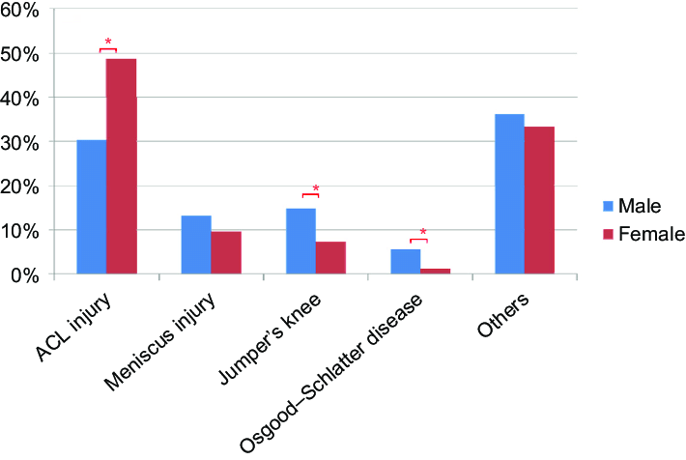
ACL Injury

Slide 14
ACL Injury
According to research, an ACL tear is one acute injury that female athletes are two to eight times more likely to experience than males.

Slide 15
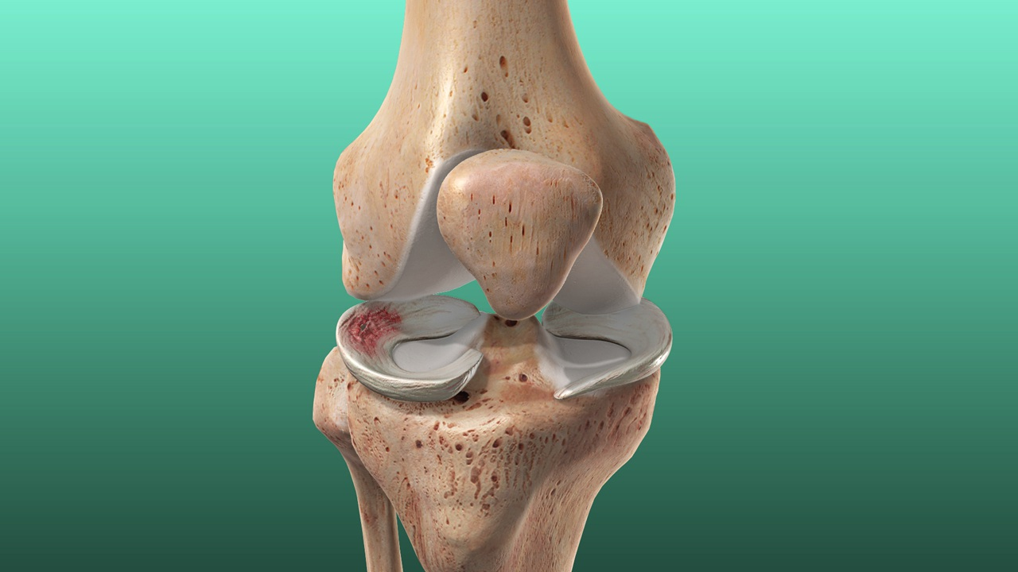
Meniscal Injury

Slide 16
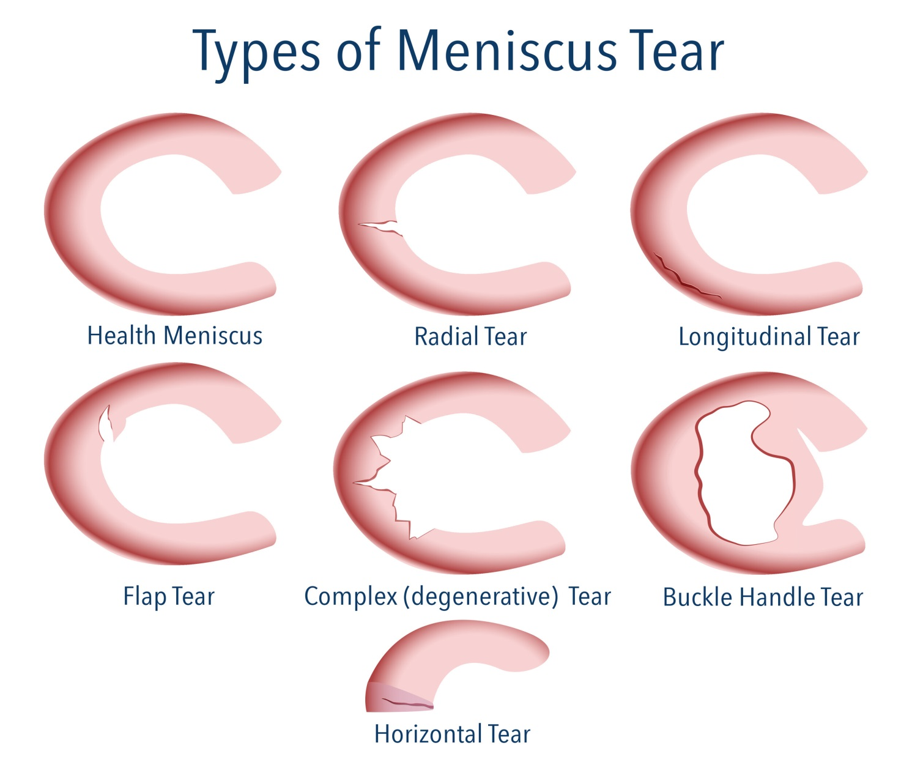
Meniscal Injury

Slide 17
Meniscal Injury
Mechanism of tearing:
An acute twisting injury from impact during a sport:
Usually the foot stays fixed on the ground and the rest of body rotates.
Getting up from squatting or crouching position.
Loading the knee from a fixed position.

Slide 18
Meniscal Injury
The most important Symptom:
KNEE LOCKING

Slide 19
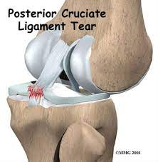
PCL injury

Slide 20
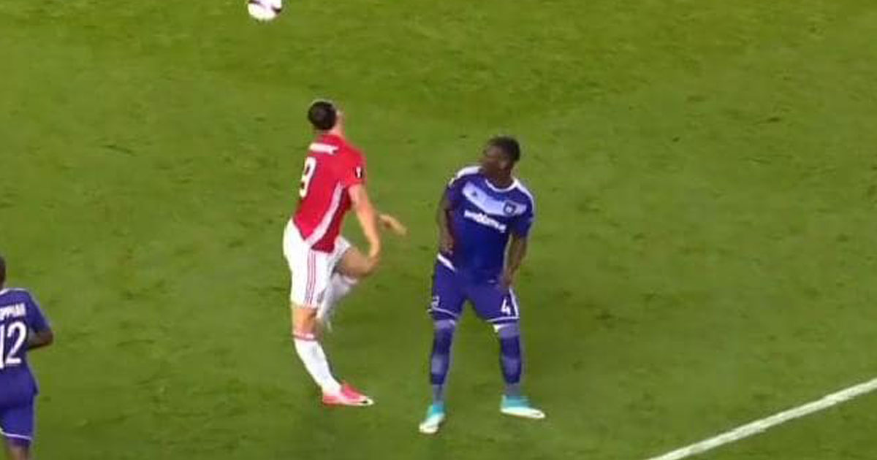
PCL injury

Slide 21
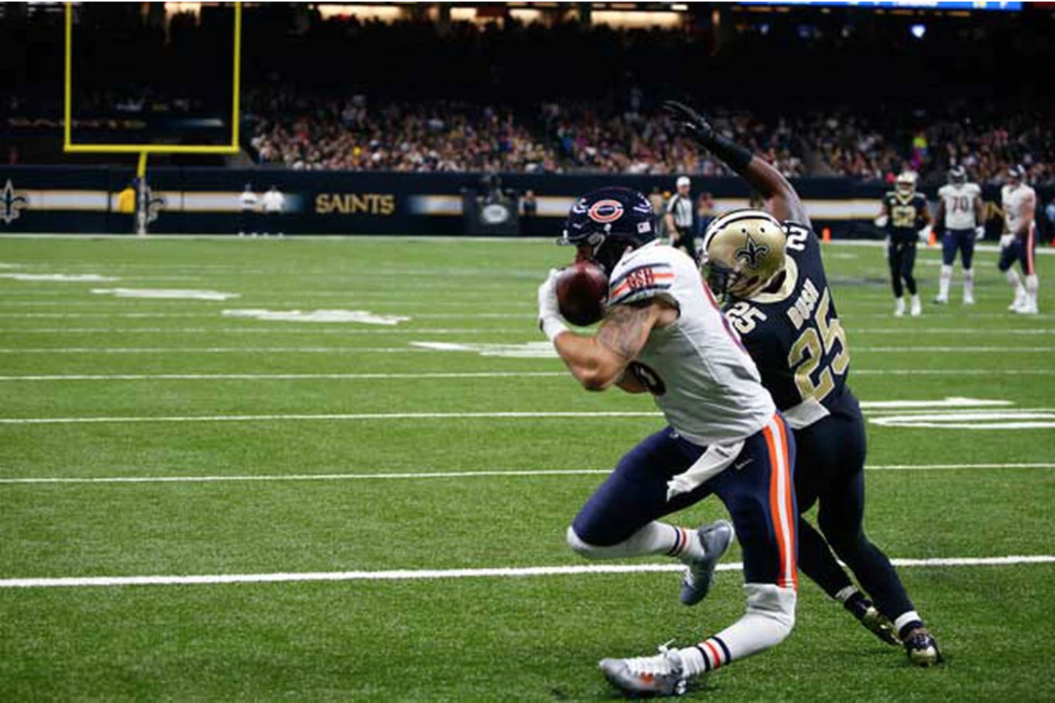
PCL injury

Slide 22
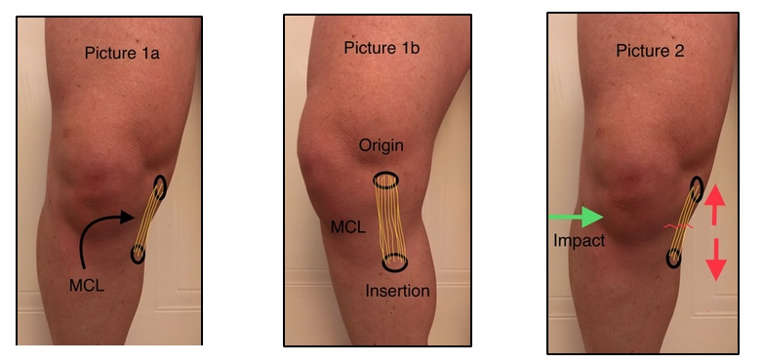
MCL Injury

Slide 23
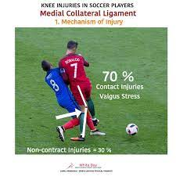
MCL injury

Slide 24
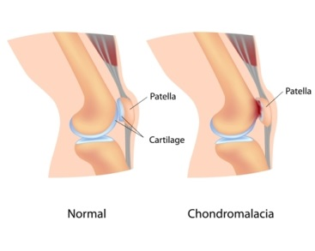
Patellar Chondromalacia

Slide 25
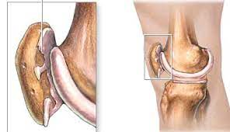
Patellar Chondromalacia

Slide 26
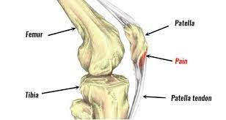
Patellar Tendinitis (Jumpers Knee)

Slide 27
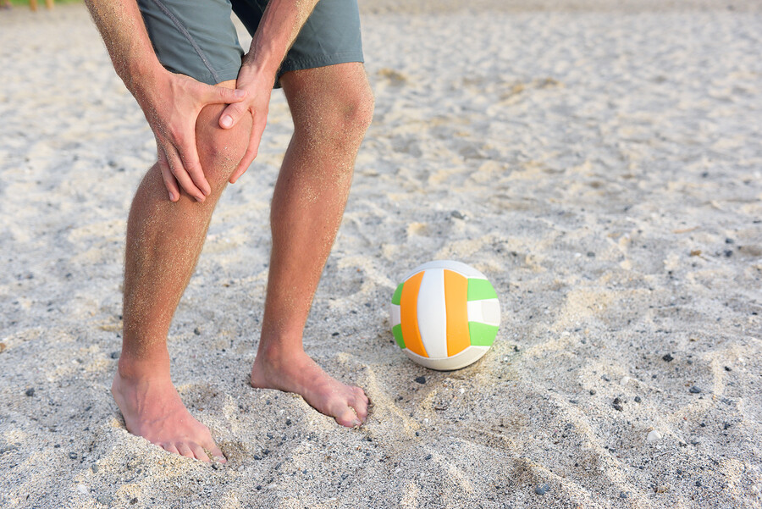
Patellar Tendinitis (Jumpers Knee)

Slide 28
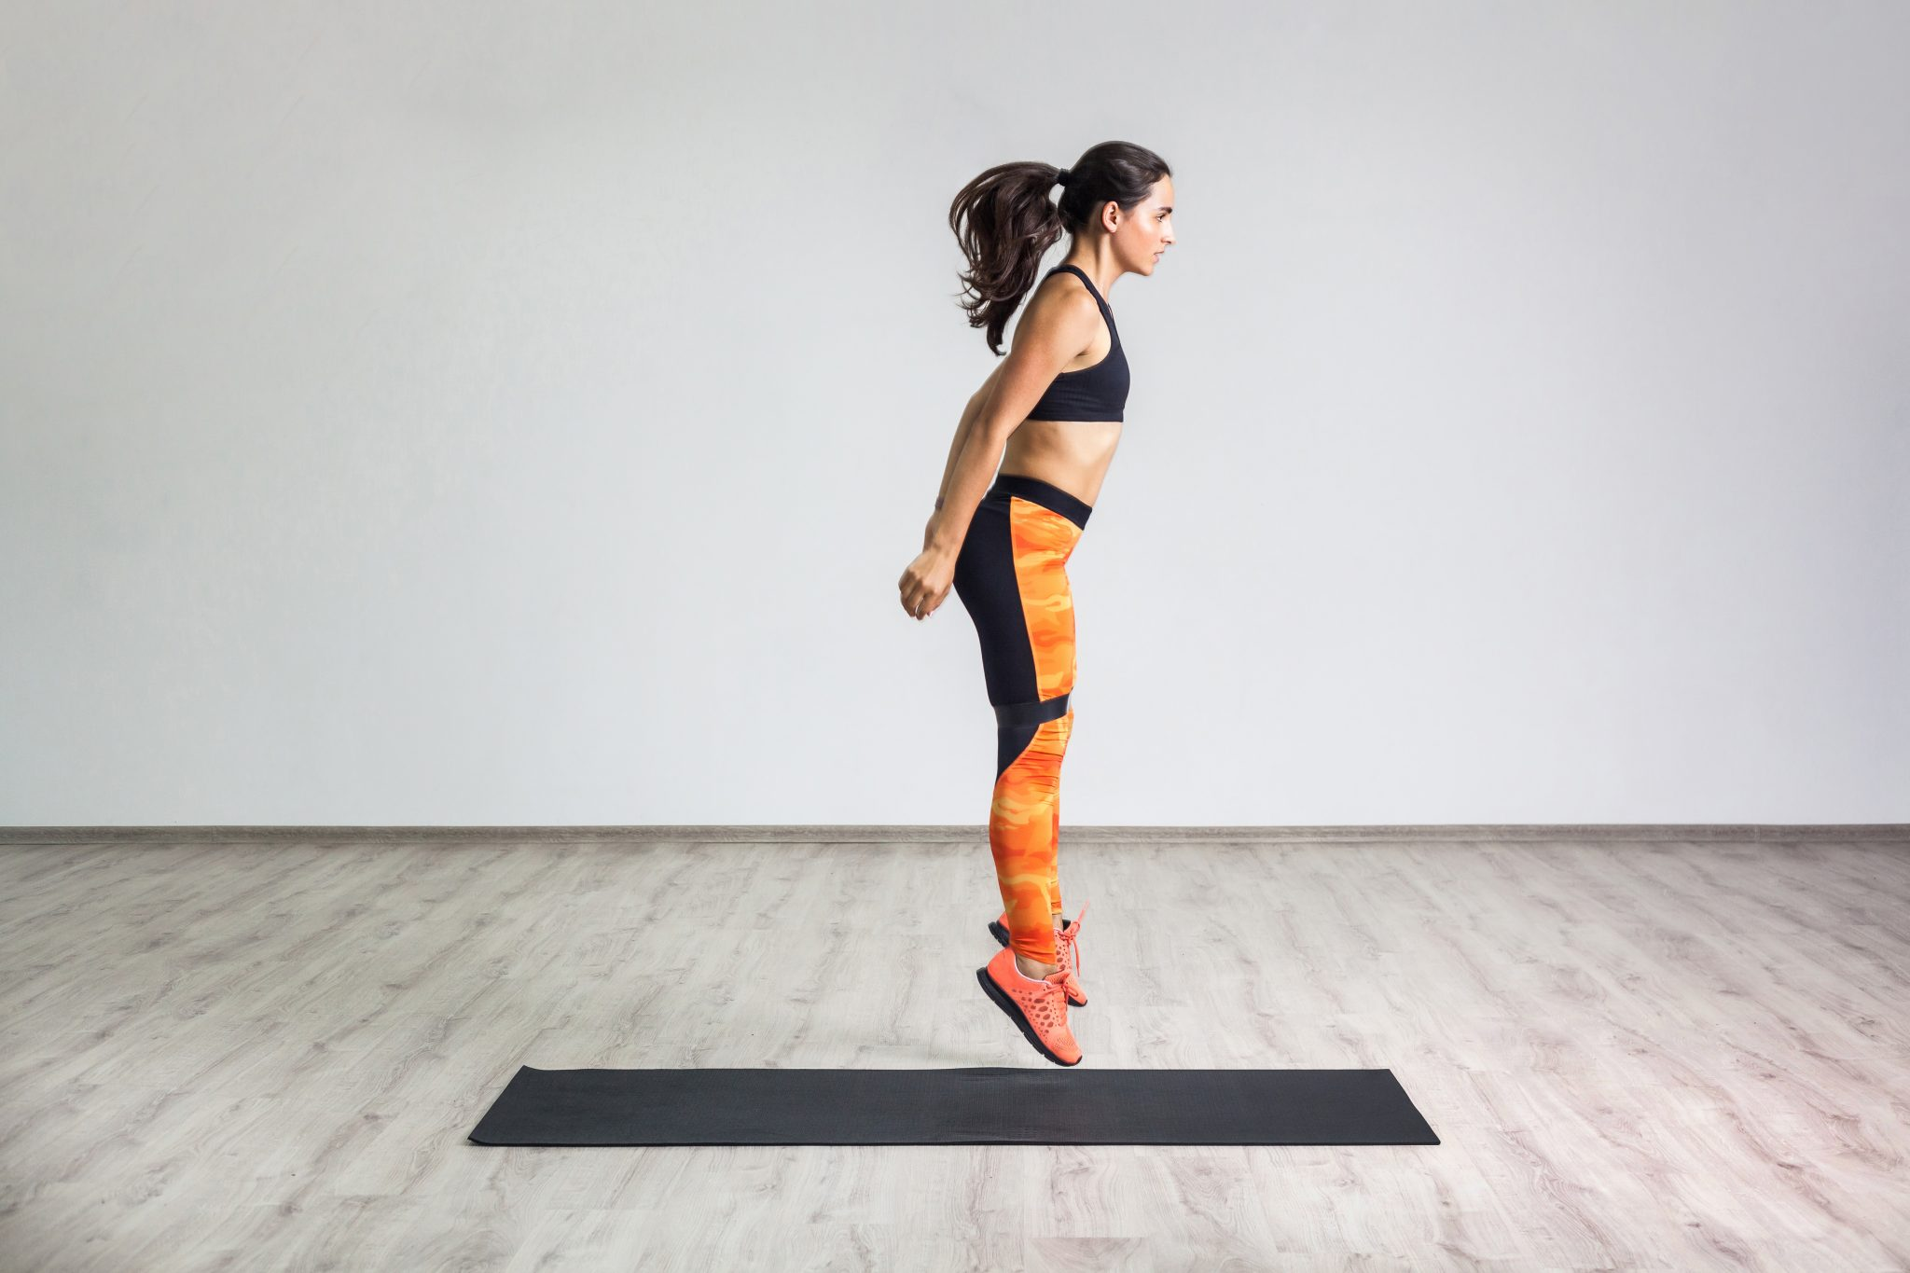
Patellar Tendinitis (Jumpers Knee)

Slide 29
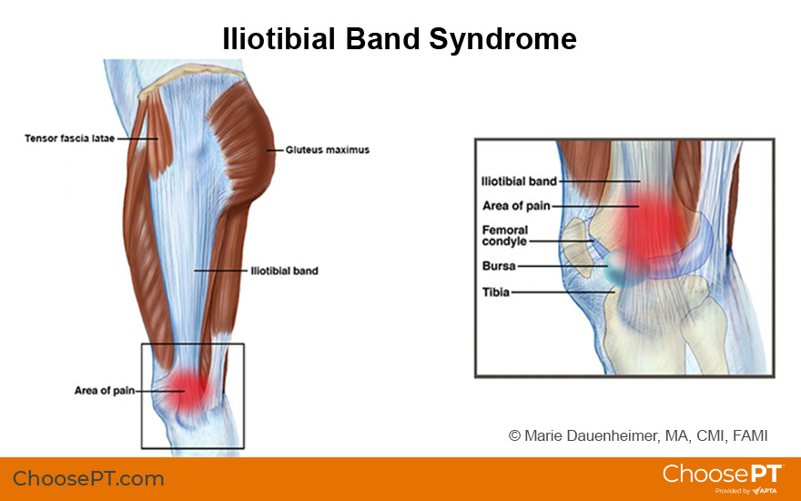
Iliotibial Band Syndrome (runners Knee)

Slide 30
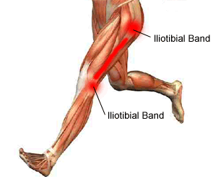
Iliotibial Band Syndrome (runners Knee)

Slide 31
Iliotibial Band Syndrome (runners Knee)
Iliotibial band pain syndrome (ITBPS) can leave the runner crippled in pain, and often appears like clockwork at a given point during a run, with the runner unable to run “through” the pain. This injury is not unique to runners: it can be seen in field athletes, basketball players, rowers & has been reported to occur in up to 24% of road cyclists. (Holmes 1993)
(Geisler 2020) The ITB is placed under the greatest compression when the knee is bent between 20-30degrees during the stance phase of gait.

Slide 32
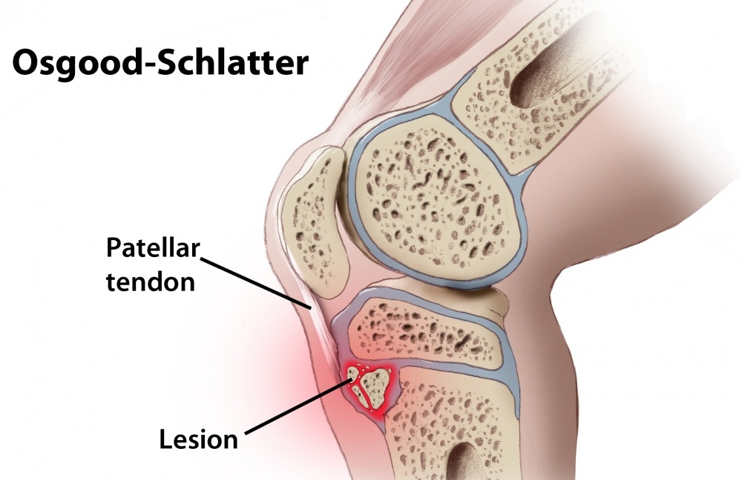
Osgood Schlatter’s Disease

Slide 33
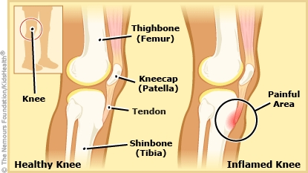
Osgood Schlatter’s Disease

Slide 34
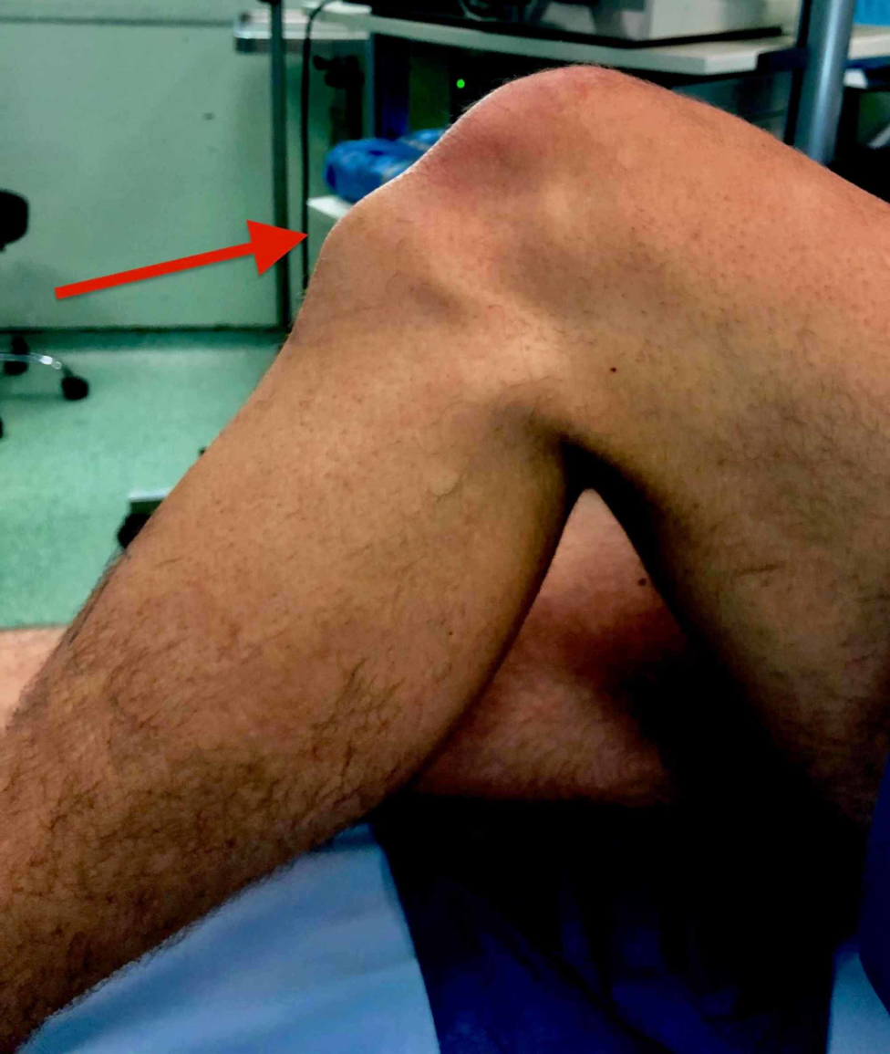
Osgood Schlatter’s Disease

Slide 35
THE END

